Slide 1
EagleSat 2:
Cosmic Ray Payload (CRP) Overview and Developments
April 13, 2019
by
Jason Hamburger

Slide 2
Outline
Mission Overview
Sensor Operation Logistics
Preliminary Testing

Slide 3
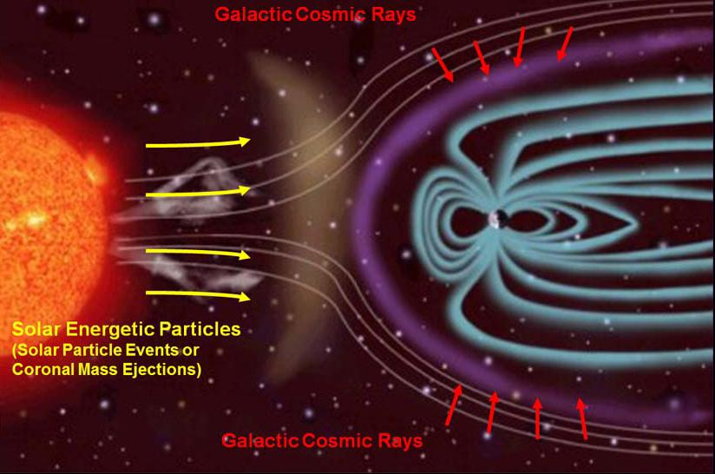
CRP – Mission Overview
Objective – to detect incoming cosmic ray particles and determine their direction and magnitude.
Types of Cosmic Rays:
  Anomalous
  Energy Levels: 10⁷ to 10⁸ eV
  Origin: Ionized interstellar atoms
  Galactic
  Energy Levels: 10¹⁰ to 10¹⁵ eV
  Origin: Shocks of supernovas
  Solar:
  Energy Levels: 10⁷ to 10⁸ eV
  Origin: Corona of the Sun
Fig CRP-1: Cosmic Ray Sources
(https://photojournal.jpl.nasa.gov/jpeg/PIA16938.jpg)
Notes:
Determine cosmic ray characteristics through image processing of the pixels
Solar Cosmic Rays
Energy Levels: 10⁷ to 10⁸ eV
Origin: Corona of the Sun
Anomalous Cosmic Rays
Energy Levels: 10⁷ to 10⁸ eV
Origin: Ionized neutral interstellar atoms
Galactic Cosmic Rays
Energy Levels: 10¹⁰ to 10¹⁵ eV
Origin: Shocks of supernovas

Slide 4
CRP – Mission Concept (1 of 2)
Two layers of CMOS sensors to detect direction
  Use straight line approximation and the known height between the two sensors
  Local direction angle θ calculated relative to the pixel array
  GPS and attitude data recorded for specific location of test
Cosmic Ray Path
CMOS Pixel Array 1
θ
CMOS Pixel Array 2
Fig CRP-3: Pixel Arrangement

Slide 5
CRP – Mission Concept (2 of 2)
An array of four CMOS sensors per layer
Two sensors have tungsten over the sensor pixel array
Two sensors have no tungsten and are directional
  Determine magnitude from pixel intensity before and after tungsten
  Estimate the energy loss through the tungsten to aid in calculation
  Directional used to compare intensity values and showering effect
Top View
(0.25 cm)
Cosmic Ray Path 1
Side View
Cosmic Ray Path 2
Sensor Array Layer 1
(0.5 cm)
Tungsten (0.5cm)
Tungsten (0.25cm)
Sensor Array Layer 2
Fig CRP-4: Sensor Arrangement Side & Top Views

Slide 6
CRP – Sensor Operation Logistics
2-5 cycles per orbit depending on:
  Current power levels
  Current data amount (Data cap ~8 kilobytes per orbit)
Run 2 sensors at a time
Alternate to new pair of sensors
5-10 second cycle time
Expecting 1 particle per square meter per second
Notes:
12 bits per pixel, but about 40 bits per pixel including data. Data cap ~8 kilobytes per orbit (includes health data, such as temperature data).

Slide 7

CRP – PiCAM Balloon Test Data
High Altitude Balloon Test Environment with sensor behind metal, battery, and foam
4 hr. flight
3 Suspect interactions
Non-streaked (2x2)
~0.0758 nm²
103 Intensity (Medium)
Proof of concept, but inconclusive data
Fig CRP-17: Sample Detection

Slide 8
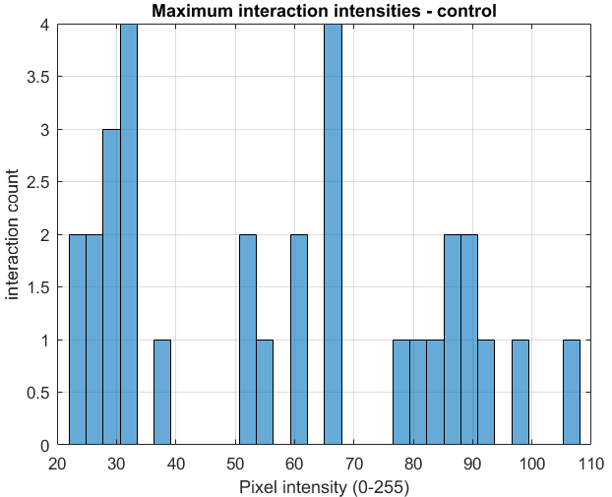
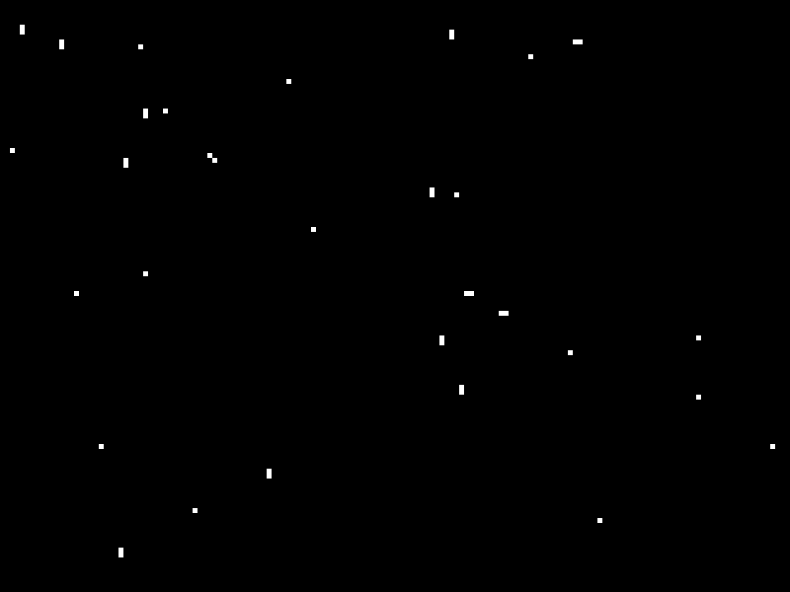
CRP – UCAM-III Test 1
Gamma Rays with no lead plating
2 hr.
31 Interactions
Non-Streaked (1x1)
108 Max Intensity
Fig CRP-18: Test 1 Detections

Slide 9
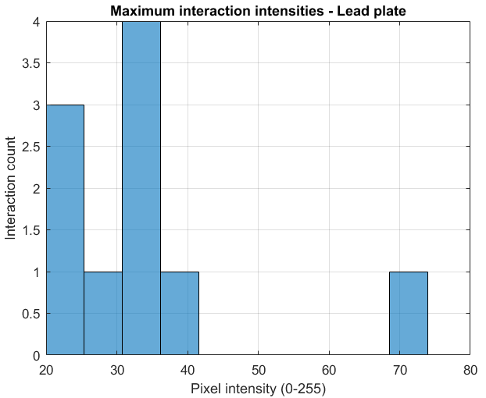
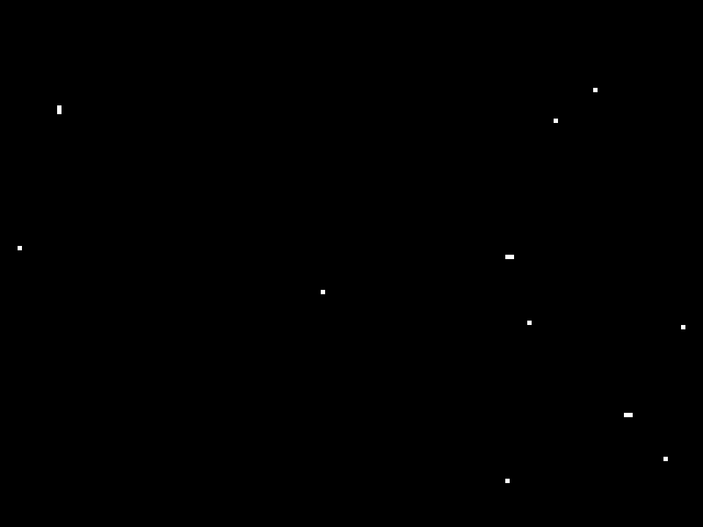
CRP – UCAM-III Test 2
Gamma Rays with lead plating
2 hr.
10 Interactions
Non-Streaks (2x2)
74 Max Intensity
Fig CRP-19: Test 2 Detections

Slide 10
CRP – UCAM-III Test 3
Alpha Particles with no lead plating
0 Interactions
Alpha Particle source was too depleted (10.5 half lives)

Slide 11
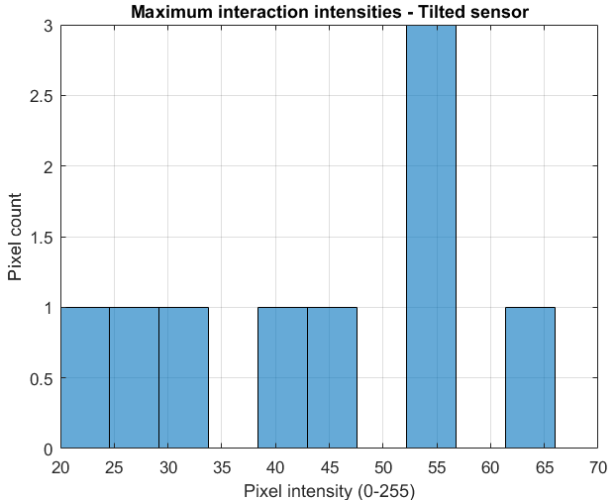
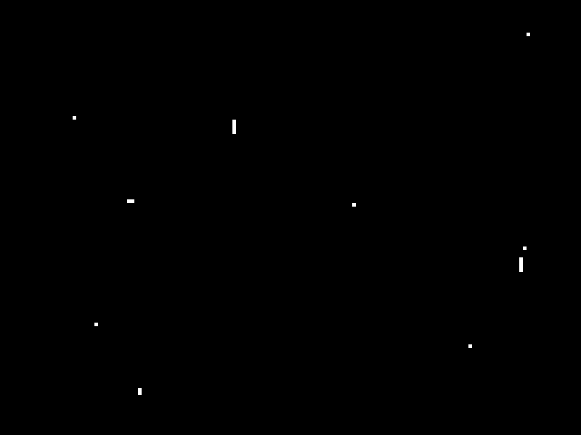
CRP – UCAM-III Test 4
Gamma Rays with Sensor tilted, no lead plating
2 hr.
9 Interactions
More particle streaking
66 Max Intensity
Fig CRP-20: Test 4 Detections

Slide 12
Questions?
Jason Hamburger
hamburj1@my.erau.edu

Slide 13
Back-Up Slides

Slide 14
CRP – Terms and Definitions
Hit: Cosmic Ray crossing both sensors’ pixel arrays with a magnitude greater than the background noise
Interaction: Cosmic Ray crossing only one sensor’s pixel array with a magnitude greater than the background noise
Sensor Capture Time: Exposure time length between sensor activation and deactivation
Magnitude: Pixel Intensity Value

Slide 15
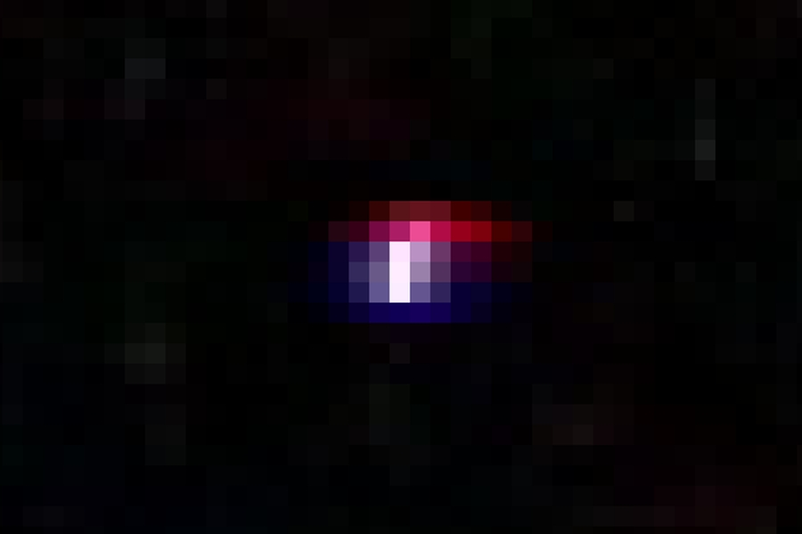
CRP – Detecting Cosmic Rays
Cloud chambers
  Ground based
  More for demonstrations
Geiger counters
  Insufficient data (only flux, no magnitude or direction)
Scintillator Detectors
  Good for magnitude, but not as much for direction
  Harder to interface with
CCD chips
  Generally more expensive
CMOS chips
  Determine cosmic ray characteristics through image processing of the pixels
  Chosen design method
Fig CRP-2: Cosmic Ray Detection
(https://www.cloudynights.com/articles/cat/articles/capturing-cosmic-rays-with-a-digital-camera-r3046)
Notes:
CCD = Charge Coupled Device
CMOS = Complementary Metal Oxide Semiconductor
Determine cosmic ray characteristics through image processing of the pixels

Slide 16
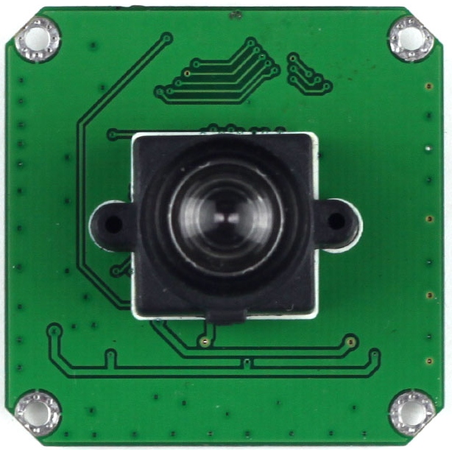
CRP – Hardware Selection
Arducam 14Mp CMOS (MT9F002)
  Mass: ~30 g
  Max Power: 0.443 W
  Dimensions: 4.0 cm x 4.0 cm x 0.45 cm (x,y,z)
  Pixel Size: 1.4 µm x 1.4 µm (x,y)
  Operational Temperature Range: -30°C to 70°C
  Easy to Interface
Fig CRP-5: Arducam
(http://www.arducam.com/products/camera-breakout-board/14mp-mt9f002/mt9f002-m12/)
Notes:
Very large power maximum. Because of our current payload design this is significantly over the expected margins; however still contacting company to verify. Mainly because most power comes from fast read out, where we are using a slow FPGA read out.

Slide 17
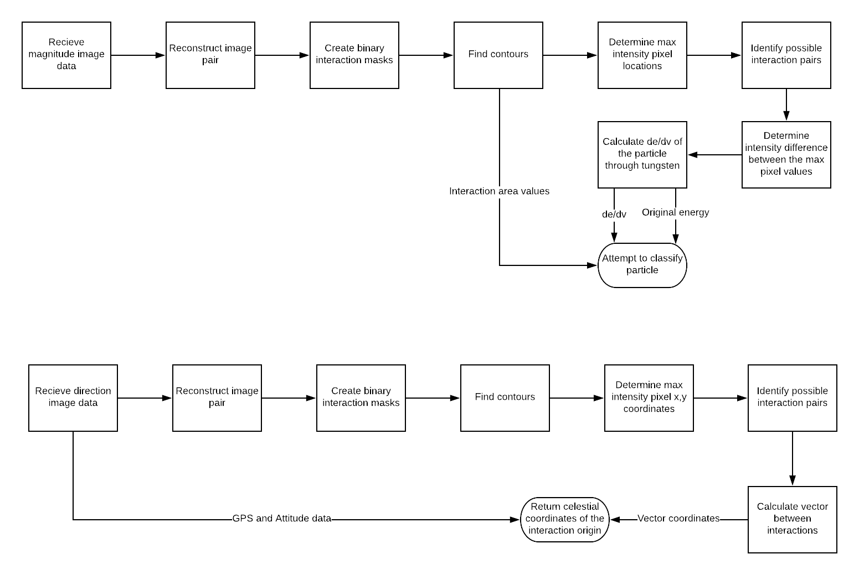
CRP – Direction Image Processing
Fig CRP-13: Direction Image Processing Block Diagram
Notes:
Note for classifying particles because of the line assumption, we should have two possible origins. Some instances may be able to narrow down to one origin. For example, if one of the possible origins is a super nova and the other origin is nothing or a black void.

Slide 18
CRP – Magnitude Image Processing
Fig CRP-14: Magnitude Image Processing Block Diagram

Slide 19
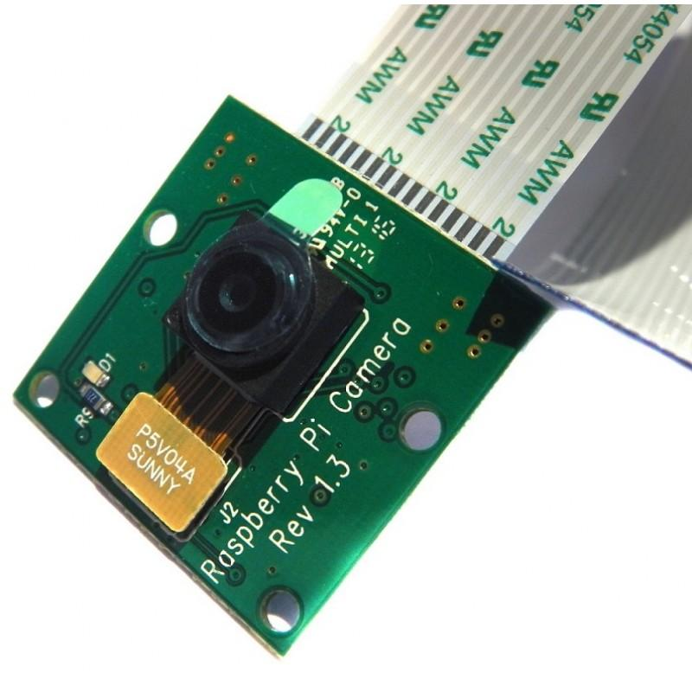
CRP – Testing Hardware
Raspberry Pi Camera Module (PiCAM)
  Mass: ~3 g
  Dimensions: 2.5 cm x 2.4 cm x 0.9 cm (x,y,z)
  Pixel Size: 1.4 µm x 1.4 µm (x,y)
  Resolution: 8 Megapixels
Fig CRP-15: Raspberry Pi Camera
(https://uk.pi-supply.com/products/raspberry-pi-camera-board-v1-3-5mp-1080p)
Notes:
Very large power maximum. Because of our current payload design this is significantly over the expected margins; however still contacting company to verify. Mainly because most power comes from fast read out, where we are using a slow FPGA read out.

Slide 20
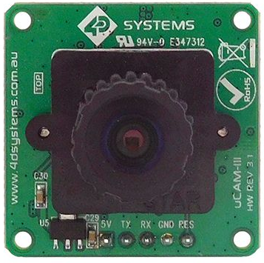
CRP – Testing Hardware
uCAM-III
  Mass: ~15 g
  Dimensions: 3.2 cm x 3.2 cm x 1.4 cm (x,y,z)
  Pixel Size: 5.55 µm x 5.55 µm (x,y)
  Resolution: 300 K pixels
Fig CRP-16: uCAM-III
(https://www.gotronic.fr/art-mini-camera-ucam-iii-27148.htm)
Notes:
Very large power maximum. Because of our current payload design this is significantly over the expected margins; however still contacting company to verify. Mainly because most power comes from fast read out, where we are using a slow FPGA read out.

Slide 21
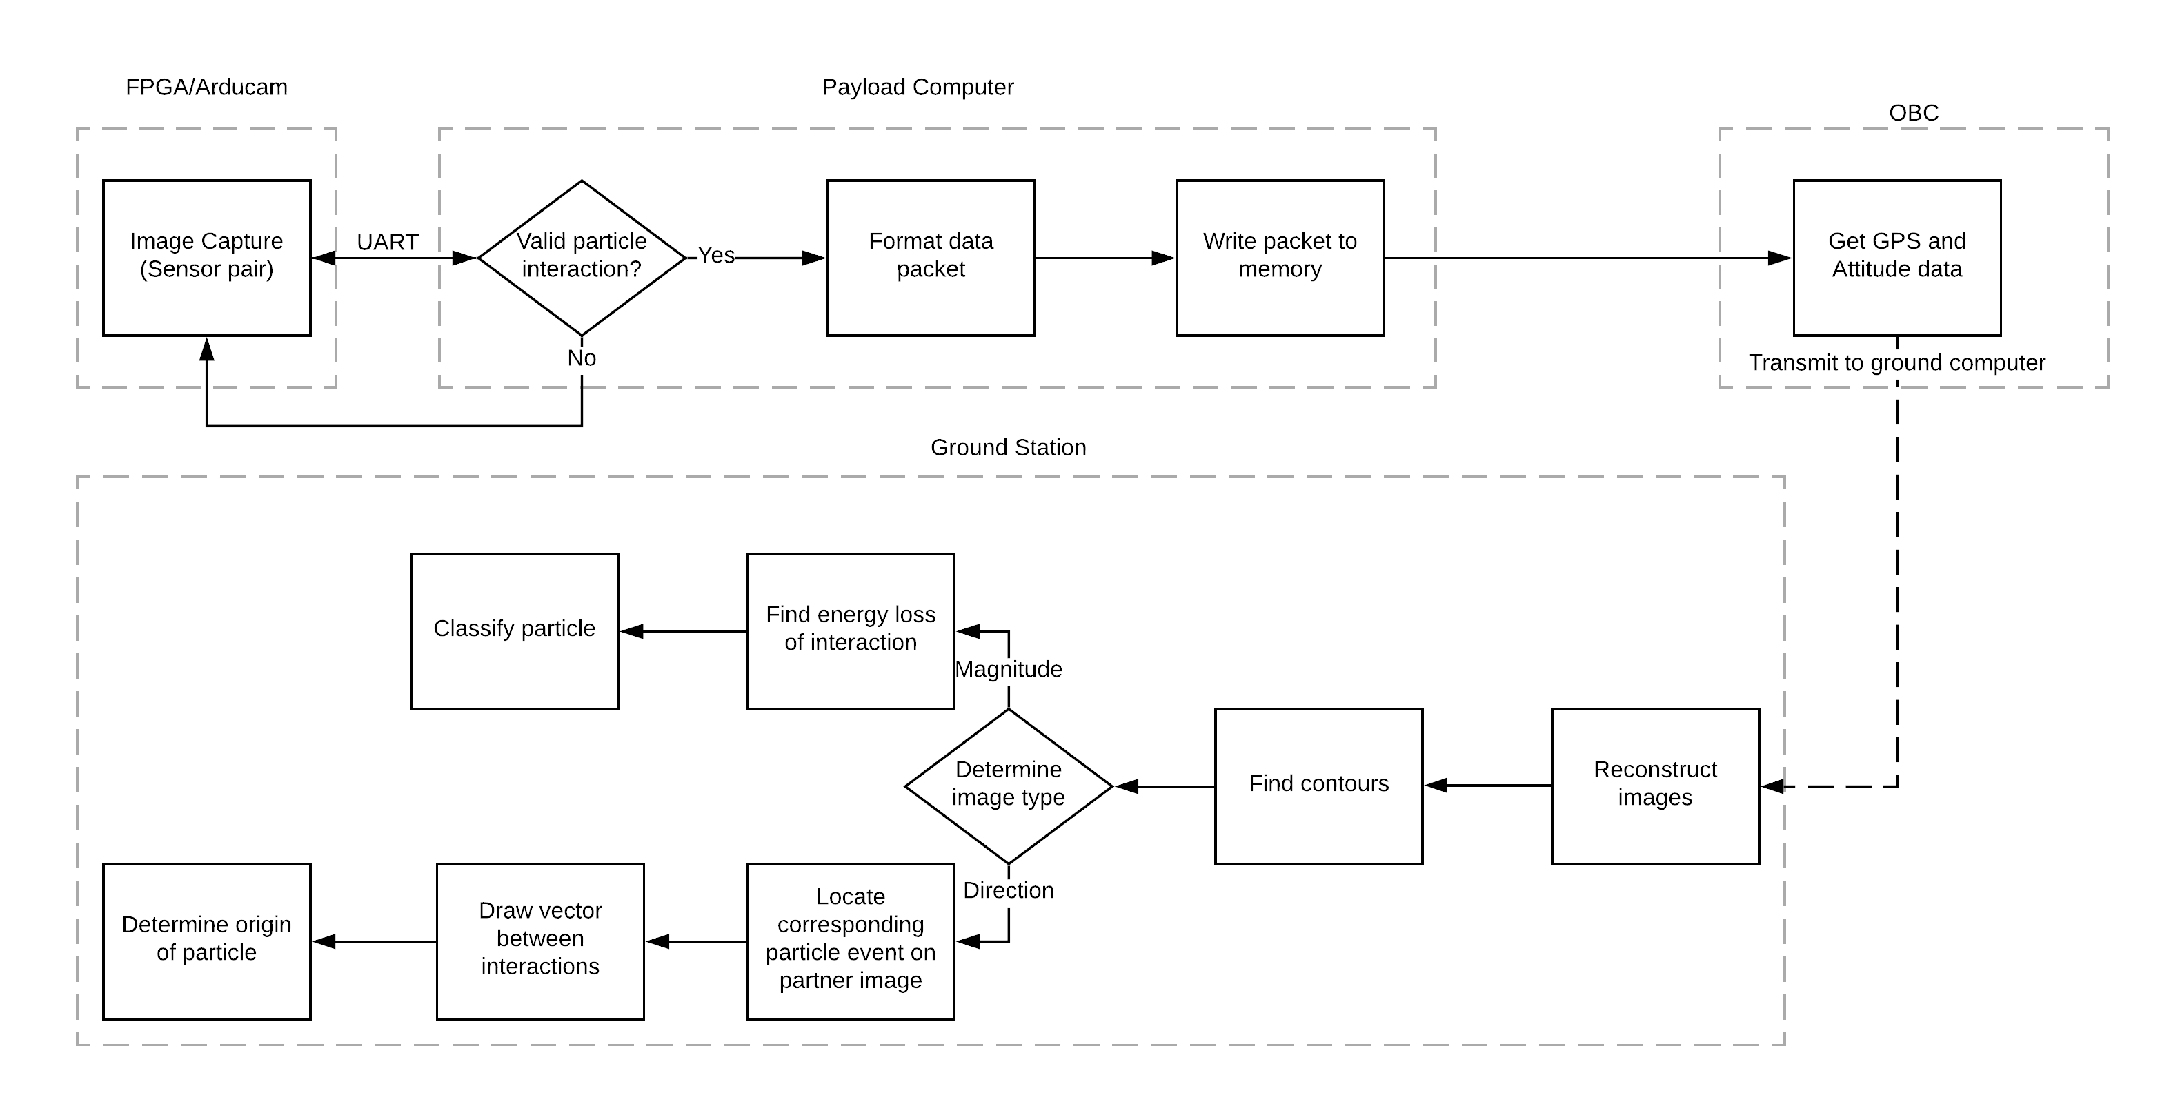
CRP – Programming Block Diagram
Fig CRP-6: Programming Block Diagram
Notes:
Reconstruct as in taking the transmitted data and reconstructing the cropped images from the transmission.

Slide 22
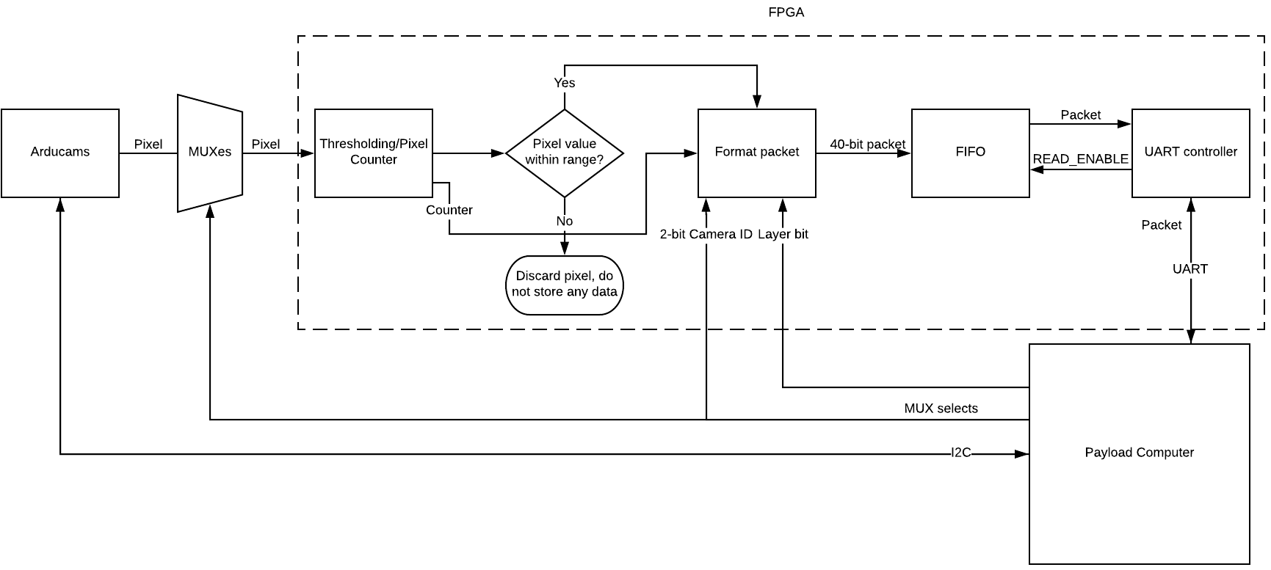
CRP – Interface Design
Fig CRP-7: Interface Design Block Diagram
Notes:
I2C between payload computer and sensors
UART between payload computer and FPGA
2 channels (one per board) for I2C and UART
GPIO between sensors and FPGA
Direct hardware reset pins (for sensors and FPGA)

Slide 23
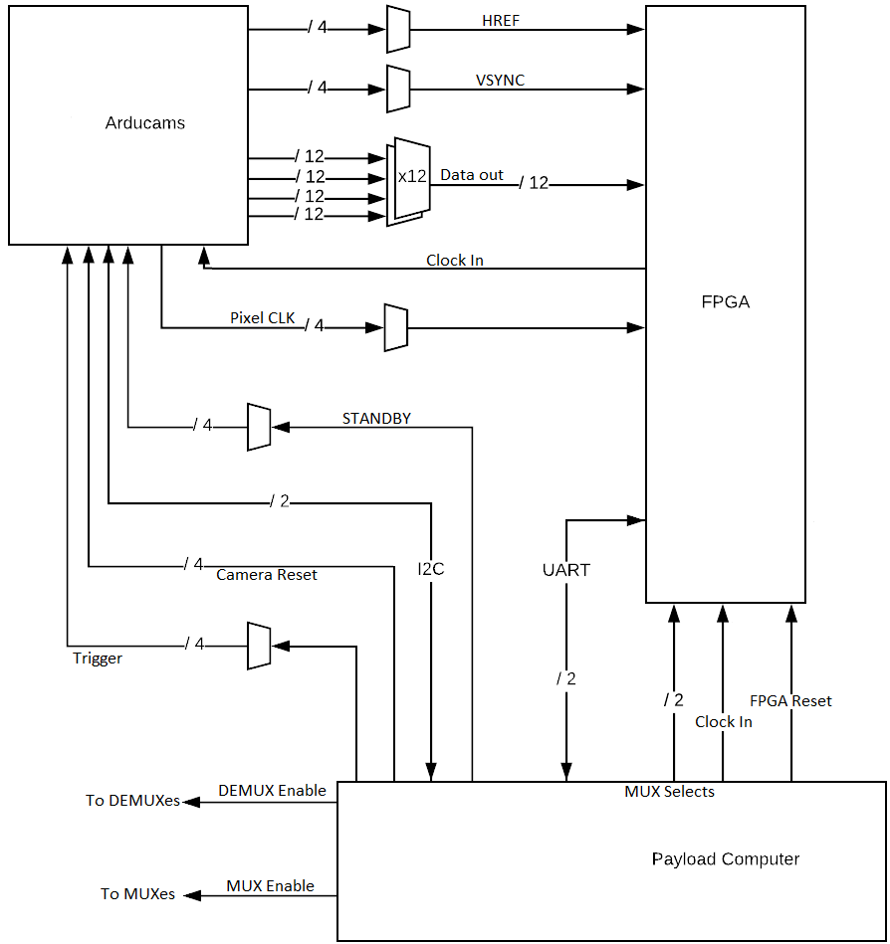
CRP – Interface Design (MUXes)
Fig CRP-8: Interface Design MUXes

Slide 24
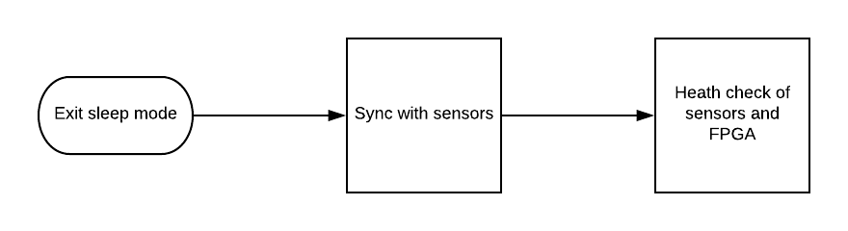
CRP – Cycle Definition (Phase 1)
Fig CRP-9: Cycle Definition Block Diagram
Notes:
Phase 1: Start Cycle
Exit sleep mode
Sync or handshake with sensors
Check state of sensors and FPGA (Is everything functioning as it should?)

Slide 25
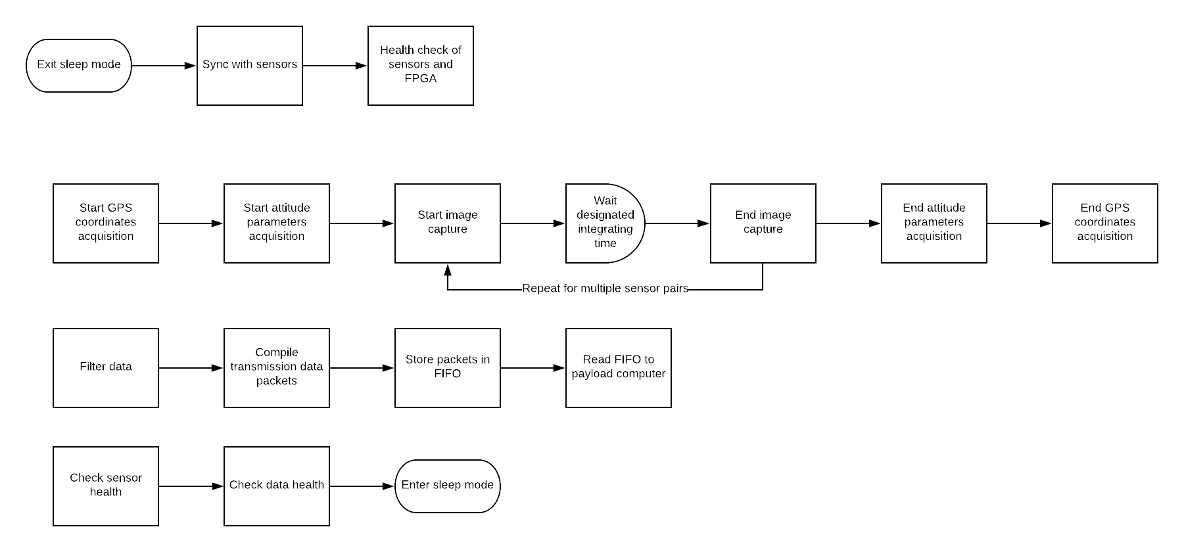
CRP – Cycle Definition (Phase 2)
Fig CRP-10: Cycle Definition Block Diagram
Notes:
Phase 2: Data Acquisition
4.1) NOTE: On Step 4, if multi-threading capability and sensor supports long exposure then simultaneously take GPS and attitude data. (Otherwise default to Steps 1, 2, 6, and 7).
4.2) NOTE: If sensor does not support long enough exposures then compile images while taking them.
Start GPS coordinates acquisition
Start attitude parameters acquisition
Start image capture sequences
Wait designated integrating time
End image capture sequences
End GPS coordinates acquisition
End attitude parameters acquisition

Slide 26
CRP – Cycle Definition (Phase 3)
Fig CRP-11: Cycle Definition Block Diagram
Notes:
Phase 3: Data Processing
Identify interactions
Magnitude
X and Y pixel coordinates
Filter data
Thresholding
Recording index of pixel with interaction
Record value of pixel with interaction
Compile transmission packet with data
Store transmission packet in FIFO
Read FIFO to payload computer

Slide 27
CRP – Cycle Definition (Phase 4)
Fig CRP-12: Cycle Definition Block Diagram
Notes:
Phase 4: End Cycle
Check state of sensors (Is everything functioning as it should?)
Check data (Is everything where it is supposed to be?)
Enter sleep mode

Slide 28
CRP – Expected Data Products
Number of interactions with the sensors
Orbit location of interactions
Direction of interactions
Magnitude of interactions
Notes:
Bring up the Definitions Backup Slide.

Slide 29
CRP – Transmitted Data
GPS and attitude data from all interactions
Pixel indices from all interactions
Pixel magnitude data from all interactions
  Pixel intensity values
  (Pixels have intensity values from 0-255. We look at BGNN < # < 255 to help determine magnitude, where BGNN stands for Back-Ground Noise Number. BGNN varies, but from preliminary tests we have been primarily using 120.)
Time of the interactions
Notes:
(Pixels have intensity values from 0-255. We look at BGNN < # < 255 to help determine magnitude, where BGNN stands for Back-Ground Noise Number. BGNN varies, but from preliminary tests we have been using 120.)

Slide 30
CRP – Sensor Trade Study
Rank Criteria | Weight % | Arducam (CMOS MT9F002) (Mini?) | RB-Spa-1132 | Adafruit TSL2591 High Dynamic Range Digital Light Sensor | uCam-III | TTL Serial JPEG Camera with NTSC Video | IC IMAGE SENSOR LUPA300 48LLC
Pixel Size (µm2) | 30% | 1.96 | 47 | 17.64 | 30.8 | 31.36 | 98
 |  | 5 | 1 | 2 | 1 | 1 | 1
Development Viability | 25% | Pre-Populated Board | Pre-Populated Board | Pre-Populated Board | Pre-Populated Board | Pre-Populated Board | No Board
 |  | 5 | 5 | 5 | 5 | 5 | 1
Detection Area (cm²) | 20% | 0.297 | 0.167 | < 0.1 | 0.1 | 0.096 | 0.2961
 |  | 2 | 2 | 1 | 2 | 1 | 2
Power (W) | 15% | 0.724 | 0.6 | 0.1235 | 0.375 | 0.375 | 0.19
 |  | 2 | 2 | 5 | 3 | 3 | 5
Volume (cm³) | 10% | 7.2 | 3.072 | 0.304 | 4.096 | 6.5 | 0.25589601
 |  | 2 | 3 | 5 | 3 | 2 | 5
TOTAL | 100% | 3.65 | 2.55 | 3.3 | 2.7 | 2.4 | 2.2

Slide 31
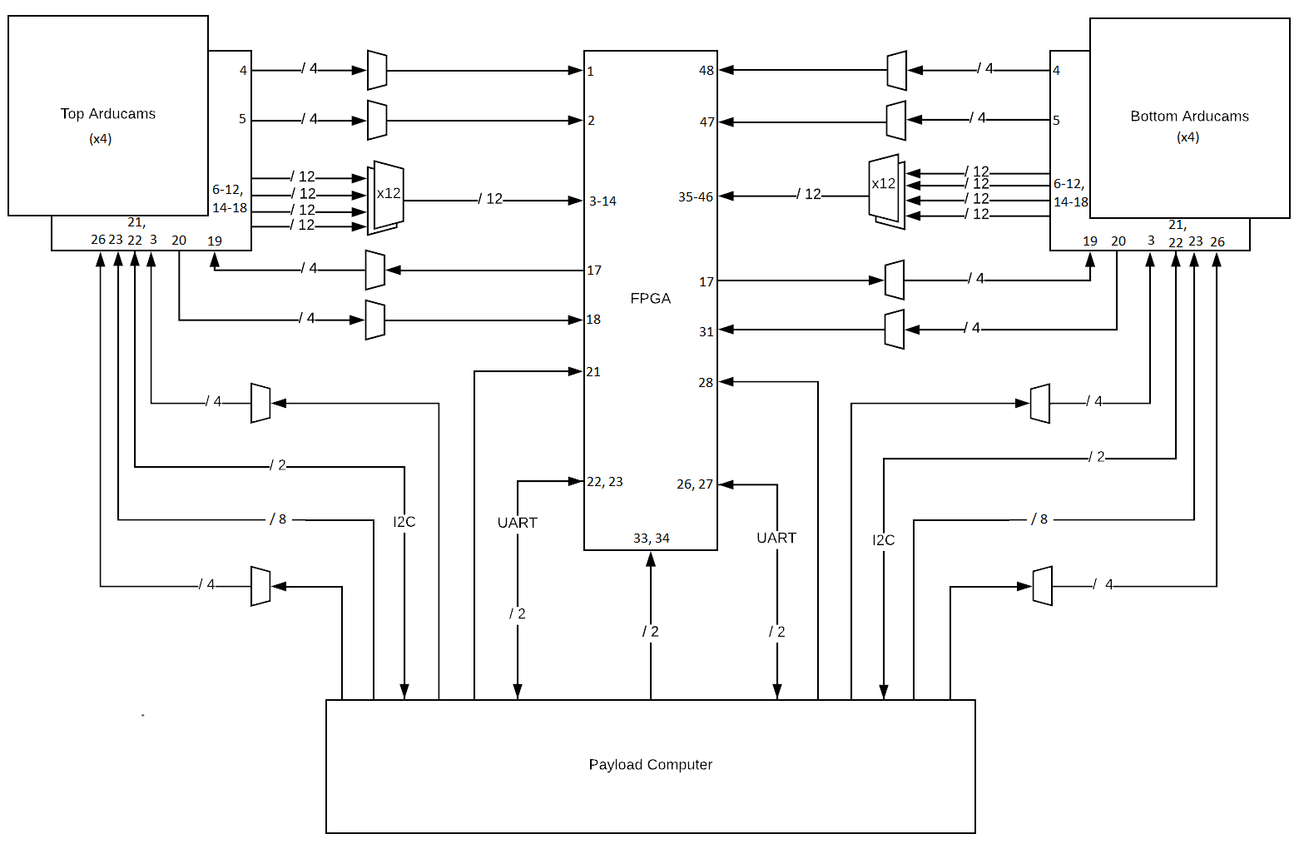
CRP – MUX Diagram
Notes:
I2C between payload computer and sensors
UART between payload computer and FPGA
2 channels (one per board) for I2C and UART
GPIO between sensors and FPGA
Direct hardware reset pins (for sensors and FPGA)

